Slide 1
Northwind Traders Business Performance Analysis
Prepared by:
Vishwanath Madawal
Tools Used:
MS Excel | SQL | Power BI

Slide 2
Northwind Traders
Valuable Business Insights
The Northwind Traders Power BI dashboard delivers meaningful insights into the company’s overall business performance by analyzing sales, customers, products, suppliers, and employees. Through interactive visualizations and KPIs, stakeholders gain a clear understanding of revenue trends, high-performing products, key customers, and regional sales distribution. This data-driven approach enables better visibility into operational performance and strategic outcomes.
Improvement Focus
The dashboard helps identify areas requiring improvement by highlighting sales fluctuations, uneven product contributions, and regional performance gaps. Analysis of order volume, average order value, and supplier pricing reveals opportunities to optimize pricing strategies, improve inventory planning, and enhance supplier relationships. These insights support revenue growth and operational efficiency.
Evaluation of Business Effectiveness
By evaluating metrics such as total revenue, order volume, customer count, and employee contribution, the dashboard assesses the effectiveness of business operations. It measures how products, suppliers, and employees contribute to overall performance, allowing management to evaluate efficiency across departments and refine business strategies accordingly.
Customer Analysis
Sales Analysis
Product Analysis
Supplier Analysis
Employee Analysis

Slide 3
Trend Identification
Using historical order and sales data, the dashboard identifies long-term and seasonal trends in revenue and customer demand. It highlights growth patterns over time, peak sales periods, and changing customer purchasing behavior. These trends assist the organization in forecasting demand, planning inventory, and preparing future sales strategies
Customer & Product Understanding
The analysis provides deep insight into customer distribution, purchasing frequency, and order value patterns. It also identifies top-performing products and categories that contribute significantly to total revenue. This understanding helps the business focus on customer retention, product prioritization, and targeted marketing initiatives.
Supplier & Regional Performance Analysis
Supplier distribution and pricing analysis reveal how different suppliers and regions impact overall sales. Geographic visualizations show revenue concentration across countries, helping the company evaluate regional market performance and optimize supply chain and distribution strategies.
Decision-Making Enablement
The project empowers decision-makers with accurate, timely, and visually intuitive insights. It supports strategic planning, operational improvements, and performance monitoring, ultimately enhancing business agility and long-term profitability.

Slide 4



Objective: The objective of this project is to analyze the business performance of Northwind Traders using historical sales data. The analysis focuses on identifying key trends, patterns, and insights related to sales, customers, products, suppliers, and employees.
Analysis Scope
Sales performance and revenue trends.
Customer behavior and order patterns.
Product and category contribution.
Supplier and employee performance.
Geographic distribution of revenue.
Goal:
To provide a complete overview of business performance and highlight growth opportunities

Slide 5
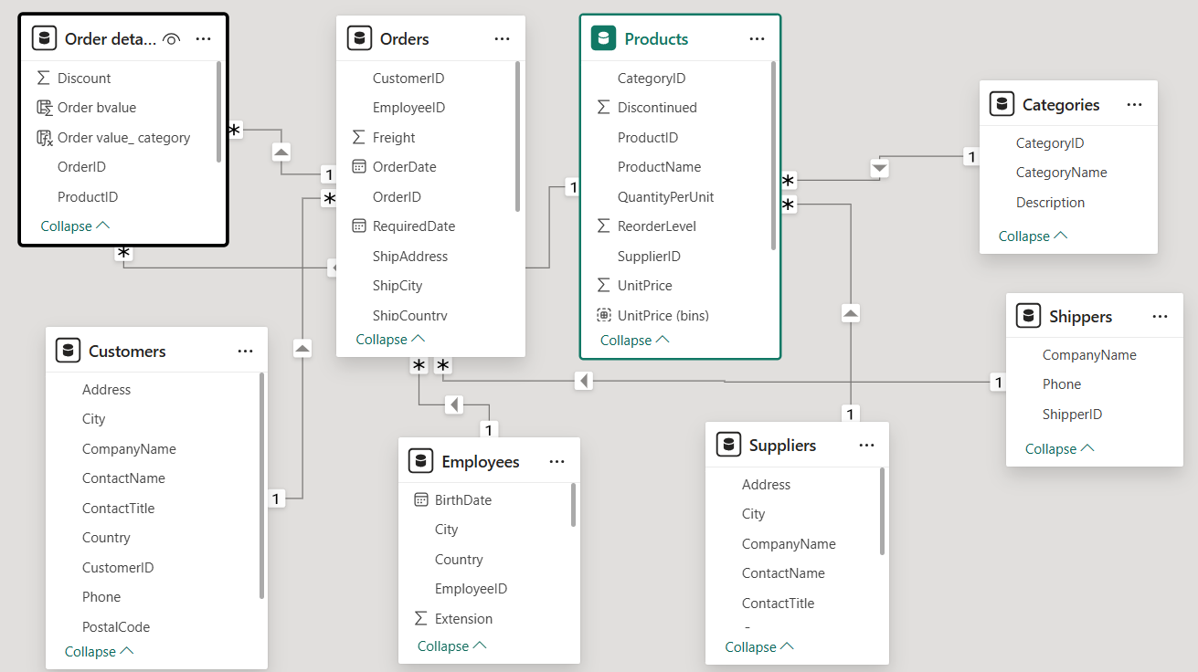
ER Diagram

Slide 6
Power BI Problem
Statements

Slide 7
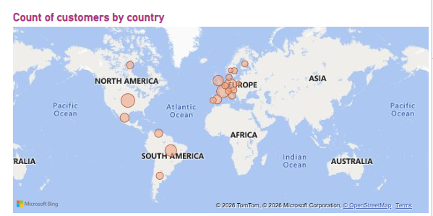
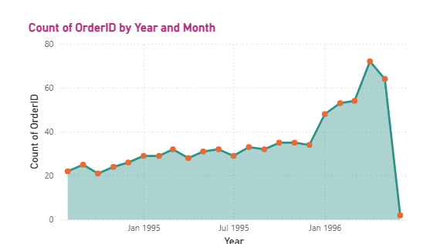
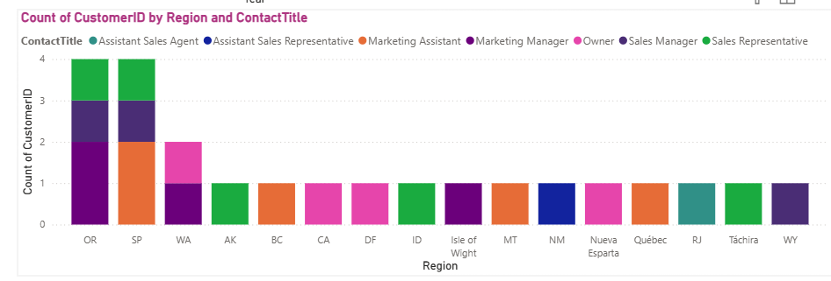
Customer Analysis

Slide 8
Customer Analysis
Customer Distribution by Geography
(Q1: Customer distribution by country/city)
The geographic analysis reveals that customers are unevenly distributed across countries and cities. A higher concentration of customers is observed in specific regions, indicating strong market presence and demand in those areas. This insight helps identify core markets as well as regions with potential for business expansion.
Key Insight:
Customer base is concentrated in a few key countries, contributing significantly to total sales.
Emerging regions show growth potential for targeted marketing strategies.
Customer Order Trend Over Time
(Q2: Trend in customer orders over time)
The time-based analysis of customer orders shows a generally increasing trend with periodic fluctuations. These fluctuations suggest seasonality in customer purchasing behavior, reflecting demand cycles across different periods.
Key Insight:
Customer engagement has strengthened over time.
Seasonal spikes indicate opportunities for promotional campaigns during peak periods.

Slide 9
Customer Distribution by Contact Title / Region
(Q3: Customers by Contact Title or Region)
This analysis highlights how customers are distributed across different contact titles and regions. Certain contact roles dominate the customer base, indicating the primary decision-makers involved in purchases.
Key Insight:
A few contact titles account for the majority of orders.
Regional distribution suggests variation in customer structure across markets.

Slide 10
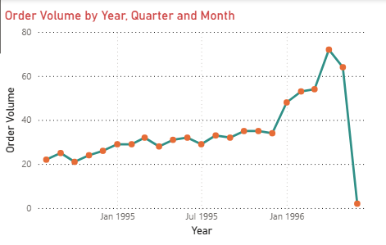
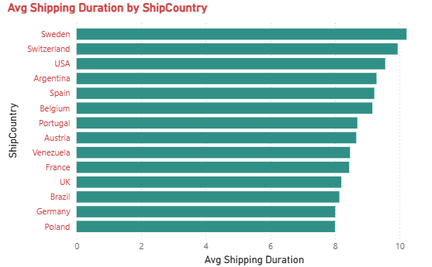
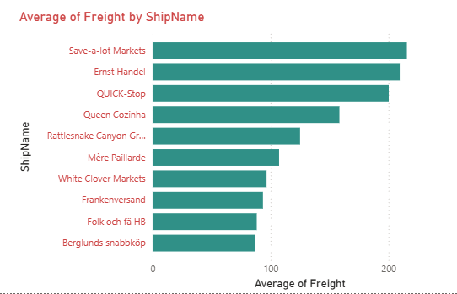
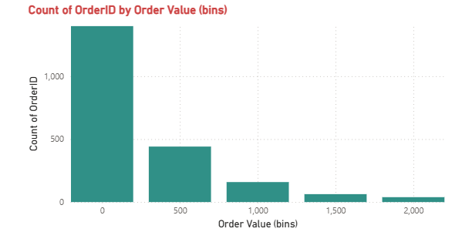
Sales Analysis

Slide 11
Sales & Orders Analysis
Order Volume Trend
(Q4: Order volume over time)
The order volume trend demonstrates a steady rise in the number of orders over time, with visible peaks and dips. This pattern reflects business growth while also highlighting periods of higher operational demand.
Key Insight:
Increasing order volume indicates business growth.
Order fluctuations align with customer demand cycles.
Distribution of Order Values
(Q5: Distribution of order values)
Order value distribution analysis shows that most orders fall within a lower-to-mid value range, while a smaller number of high-value orders contribute significantly to overall revenue.
Key Insight:
Revenue is driven by a mix of frequent low-value and fewer high-value orders.
High-value orders have a strong impact on total revenue.

Slide 12
Average Shipping Duration
(Q6: Average order shipping duration)
Shipping duration analysis reveals differences in delivery times across regions and shipment destinations. While most orders are delivered within an acceptable timeframe, some regions experience longer shipping durations.
Key Insight:
Shipping performance is consistent overall.
Opportunities exist to optimize logistics in slower delivery regions.

Slide 13
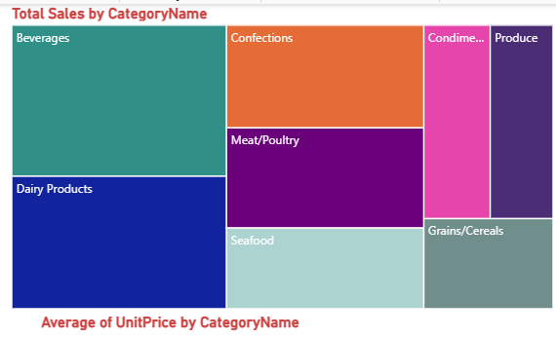
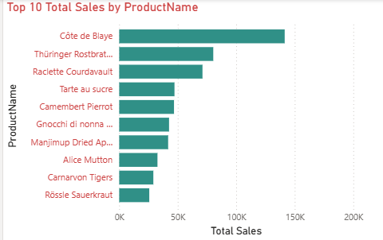
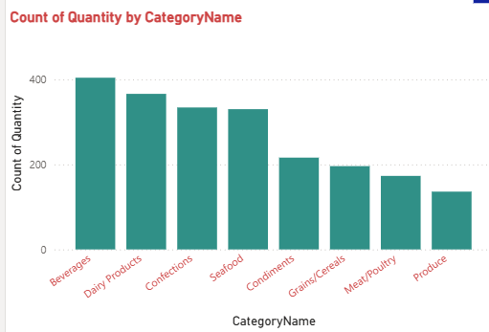
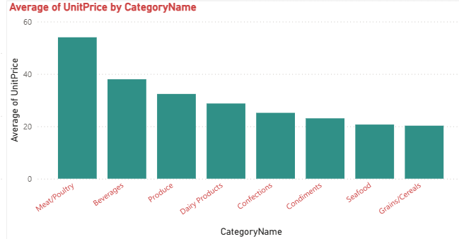
Product Analysis

Slide 14
Product Analysis
Top-Selling Products
(Q10: Products with highest sales volume)
Product performance analysis identifies a small number of products contributing disproportionately to total sales. These products form the backbone of the company’s revenue.
Key Insight:
Top products drive a significant portion of revenue.
Focus on high-performing products can maximize profitability.
Sales by Product Category
(Q11: Sales across product categories)
Category-level analysis reveals variation in sales contribution across different product groups. Certain categories consistently outperform others in terms of revenue and order volume.
Key Insight:
A few categories dominate total sales.
Underperforming categories may require repositioning or promotion.

Slide 15
Product Pricing Distribution
(Q12: Pricing distribution of products)
Pricing distribution analysis shows a wide range of product prices, with most products clustered in a moderate price band and a few premium-priced items.
Key Insight:
Pricing strategy balances affordability and premium offerings.
Price variation supports diverse customer segments.

Slide 16
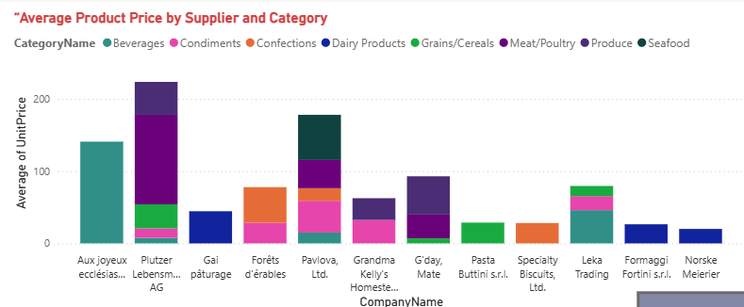
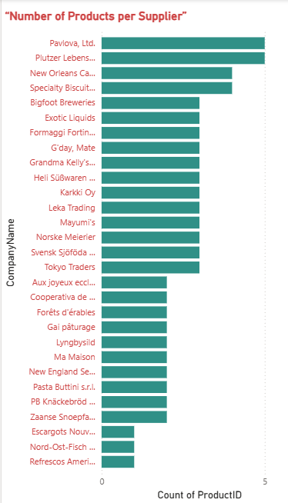
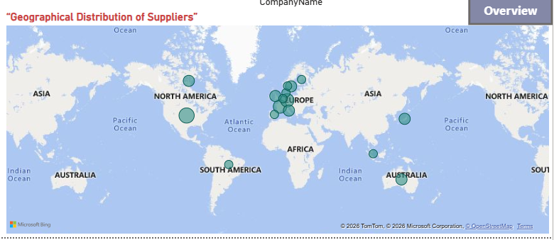
Supplier Analysis

Slide 17
Supplier Analysis
Products Supplied by Each Supplier
(Q13: Products per supplier)
Supplier analysis highlights the number of products supplied by each supplier, showing that some suppliers play a more critical role in inventory availability.
Key Insight:
Key suppliers contribute a large share of products.
Supplier dependency should be monitored to reduce risk.
Pricing Variation Across Suppliers
(Q14: Product pricing by supplier)
Pricing comparison across suppliers reveals noticeable variation in product costs. This indicates differences in supplier pricing strategies and cost structures.
Key Insight:
Pricing differences offer negotiation opportunities.
Supplier pricing impacts overall profit margins.

Slide 18
Geographical Distribution of Suppliers
(Q15: Supplier geographic distribution)
The geographic analysis of suppliers shows a concentration in specific regions, with some suppliers operating closer to major markets.
Key Insight:
Supplier locations influence shipping time and logistics costs.
Regional diversification can improve supply chain resilience.

Slide 19
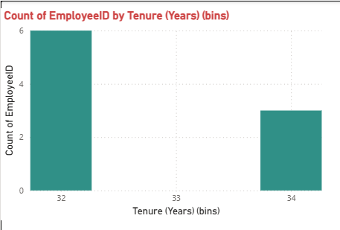
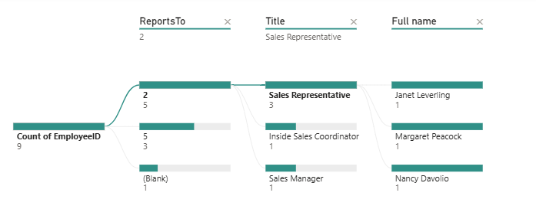
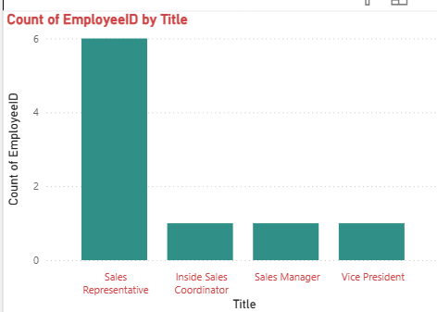
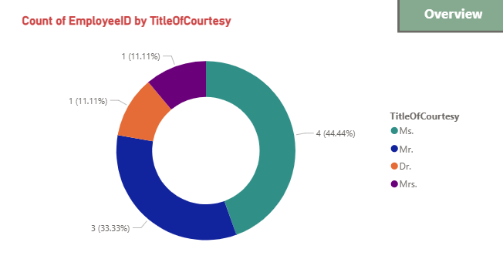
Employee Analysis

Slide 20
Employee Analysis
Employee Count by Job Title / Region
(Q7: Employee count by job title or region)
The workforce analysis shows how employees are distributed across different job titles and regions. Operational and sales-related roles form the largest share of the workforce.
Key Insight:
Employee distribution aligns with operational needs.
Certain regions employ more staff to support higher business activity.
Employee Tenure Distribution
(Q8: Distribution of employee tenure)
Tenure analysis highlights a mix of experienced and relatively new employees. This balance reflects workforce stability along with ongoing talent acquisition.
Key Insight:
A stable core workforce supports operational continuity.
New hires indicate business expansion and growth.

Slide 21
Employee Reporting Structure
(Q9: Reporting structure among employees)
The hierarchical analysis illustrates the reporting structure within the organization, showing clear managerial levels and reporting relationships. This structure supports effective communication and operational control.
Key Insight:
Well-defined reporting hierarchy enhances accountability.
Organizational structure supports efficient decision-making.

Slide 22
EDA Problem Statements

Slide 23
What is the average number of orders per customer? Are there high-value repeat customers?
How do customer order patterns vary by city or country?
Can we cluster customers based on total spend, order count, and preferred categories?
Which product categories or products contribute most to order revenue? 5 .Are there any correlations between orders and customer location or product category?
How frequently do different customer segments place orders?
What is the geographic and title-wise distribution of employees?
What trends can we observe in hire dates across employee titles?
What patterns exist in employee title and courtesy title distributions?
Are there correlations between product pricing, stock levels, and sales performance?
How does product demand change over months or seasons?
Can we identify anomalies in product sales or revenue performance?
Are there any regional trends in supplier distribution and pricing?
How are suppliers distributed across different product categories?
How do supplier pricing and categories relate across different regions?

Slide 25
THANK YOU

